Slide 1

SMS Spam Detection
An AI/ML Internship Project Report — Codec Technologies
Name: Tarun Kumar Yadav
Roll No.: 25SCS1003003532

Slide 2
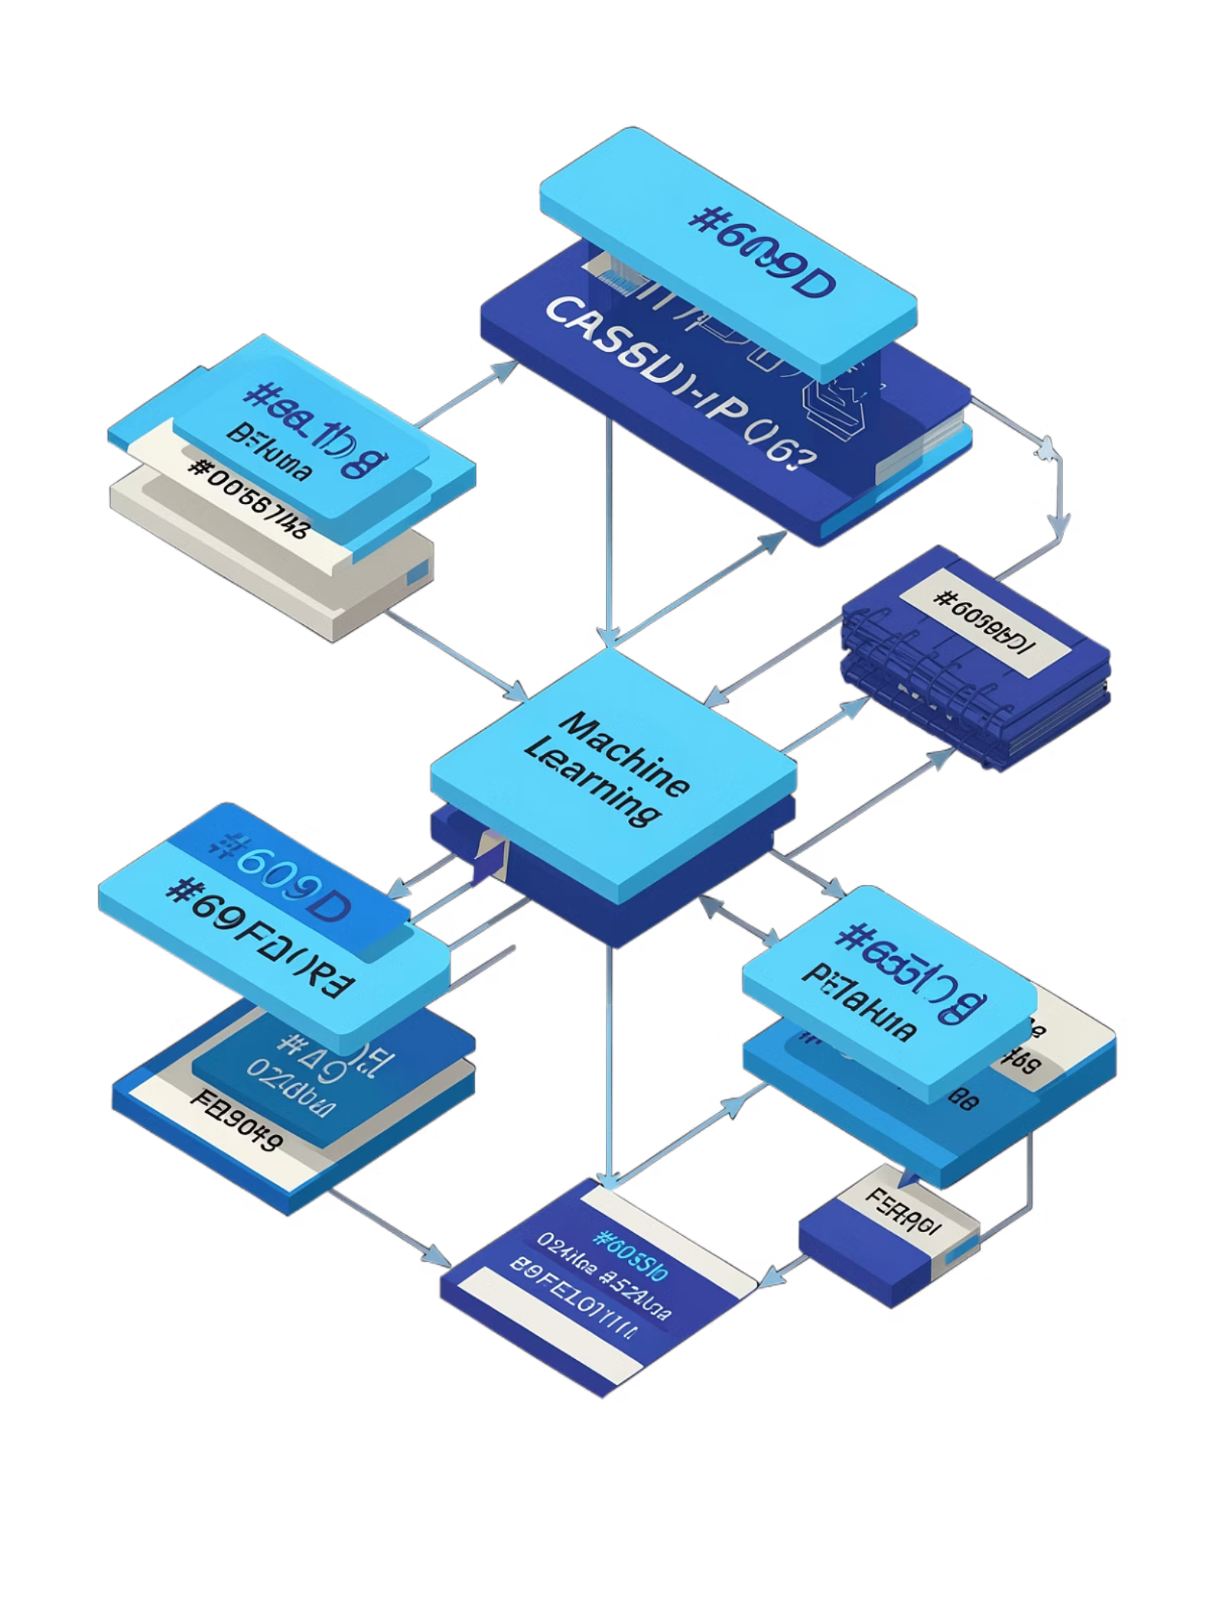
Project Overview
Objective
Approach
Automatic classification of SMS messages as spam or ham (legitimate) using NLP and machine learning
Applied NLP techniques to distinguish unsolicited, promotional, or fraudulent messages from genuine ones
Final Result
98.16% accuracy and 99.17% precision on the held-out test set

Slide 3


The Problem
Evolving Threat
Limits of Simple Filters
Data-Driven Need
Unsolicited spam ranges from harmless promotional content to phishing and financial-fraud attempts
A classification system with high precision is required to avoid costly false positives
Keyword-based filters are easily bypassed and prone to misclassifying legitimate messages at scale

Slide 4


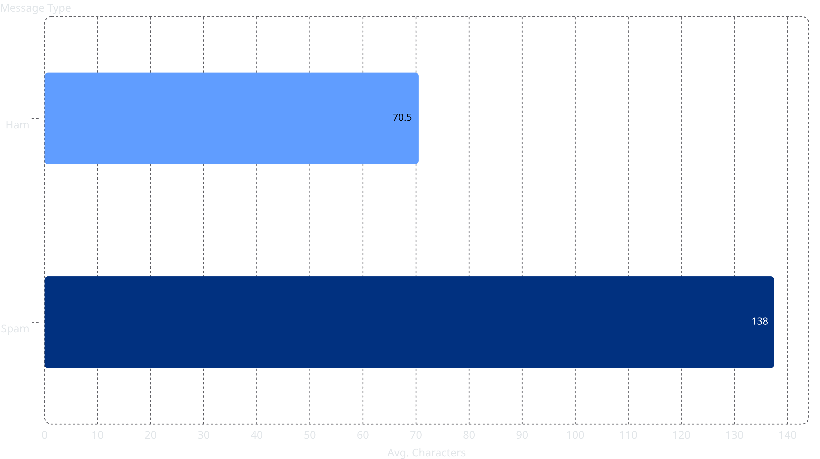
Dataset & Scope
5,572
5,169
Total Messages
Unique Messages
SMS Spam Collection dataset, labelled
After removing 403 duplicate rows
87.4%
12.6%
Ham (Legitimate)
Spam
4,516 messages
653 messages
A Key Distinguishing Feature
Spam messages average 137.5 characters versus just 70.5 characters for ham — nearly double the length. This signal proved valuable during feature engineering.

Slide 5



Technology Stack
Language & Environment
NLP & Feature Extraction
Machine Learning
Python 3 with Jupyter Notebook for interactive experimentation and reproducible analysis
NLTK for text preprocessing, scikit-learn TF-IDF vectorization with max_features = 3,000
scikit-learn and XGBoost powering 11 classifiers plus ensemble methods for final model selection

Slide 6
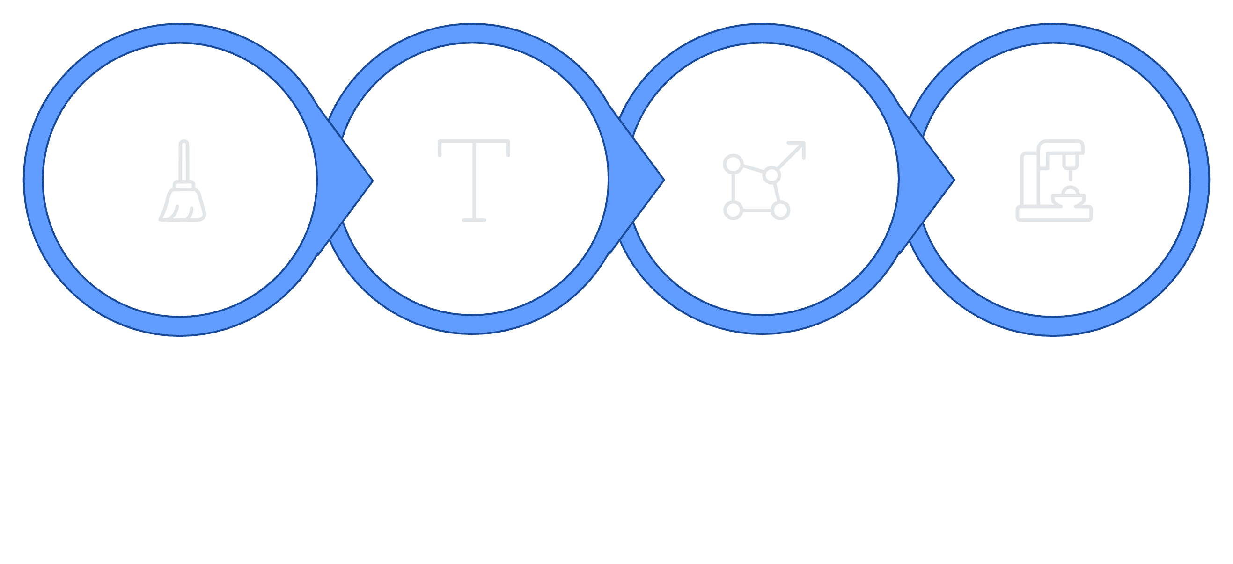
ML Pipeline Architecture
Data Cleaning
Text Pre-processing
Feature Extraction
Model Training
Each stage feeds directly into the next, producing a clean, vectorized feature matrix ready for supervised learning.

Slide 7
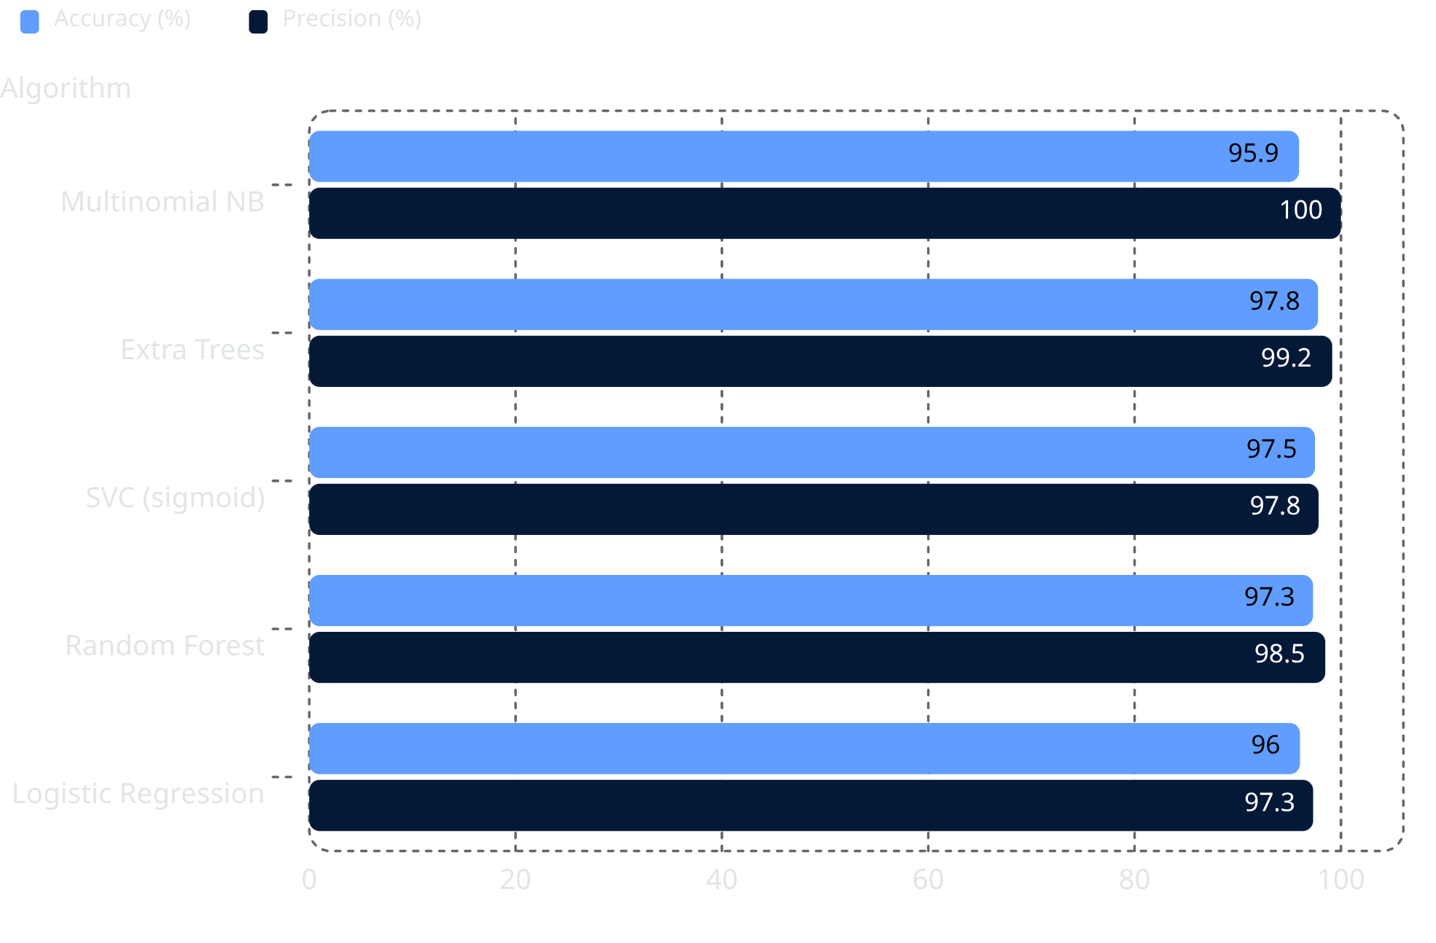
Model Comparison Results
Why Precision Matters
Eleven algorithms were evaluated on identical 80/20 train/test splits.
Precision was the primary metric — a legitimate message misclassified as spam is a worse outcome than missing a spam message.
Multinomial Naive Bayes achieved a perfect 100% precision, while Extra Trees balanced both metrics at the top of the leaderboard.

Slide 8




Ensemble Improvement
Base Estimators Selected
SVC (sigmoid), Multinomial Naive Bayes, Extra Trees Classifier — the three strongest individual models
Ensemble Strategies Tested
Soft Voting Classifier and Stacking Classifier with a Random Forest meta-learner
Final Model Chosen
Soft Voting Classifier — 98.16% accuracy and 99.17% precision, outperforming all individual classifiers

Slide 9
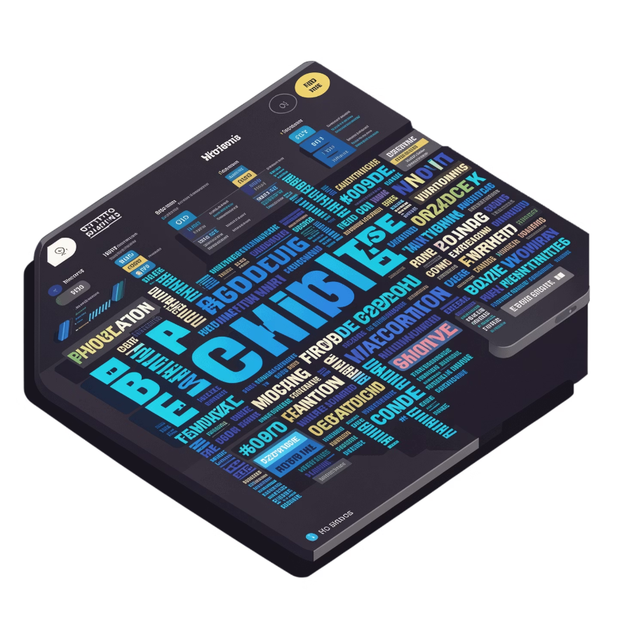
Key Outcomes Delivered
1
Clean Dataset
De-duplicated corpus of 5,169 labelled SMS messages ready for downstream use
2
Reusable Pre-processing Pipeline
transform_text() function encapsulating tokenization, stop-word removal, and Porter stemming
3
Algorithm Benchmark
Comparative evaluation of 11 supervised algorithms and ensemble strategies with full metrics
4
Supporting Visualizations
Class distribution charts, spam/ham word clouds, and correlation heat-maps

Slide 10
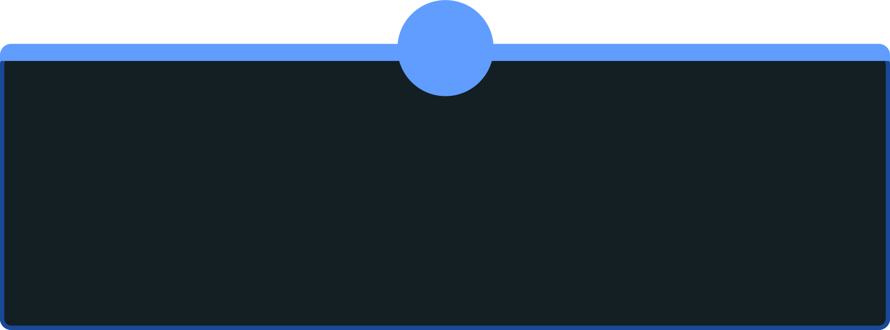

Future Enhancements
1
2
Model Packaging
Web Deployment
Serialize the final Voting Classifier with pickle/joblib for portable reuse and one-click deployment
Deploy the classifier behind a web interface to enable real-world, end-user SMS filtering
3
4
N-gram Features
Continuous Retraining
Incorporate bigram and trigram features to capture short spam phrases missed by unigram TF-IDF
Schedule periodic retraining on newer spam samples to counter concept drift as spam tactics evolve

